Slide 1


Slide 2
Accelerating Application Delivery
OpenTofu Controller and GitOps

Slide 3



Who are we?
Sr. Specialist SA, Containers
5+ Years @ AWS
tiagoReichert
tiago-reichert
Fun Fact:
I’ve never had tofu

Slide 4
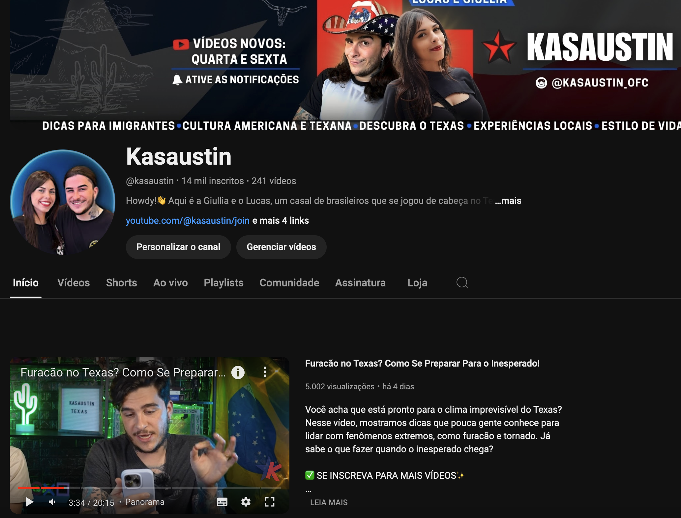

Who are we?
Sr. Specialist SA, Containers
4+ Years @ AWS
lusoal
lucas-soriano-alves-duarte
Fun Fact:
I’m a YouTuber

Slide 5






The operational model evolution
Application development team
Infrastructure/ops team

Slide 6
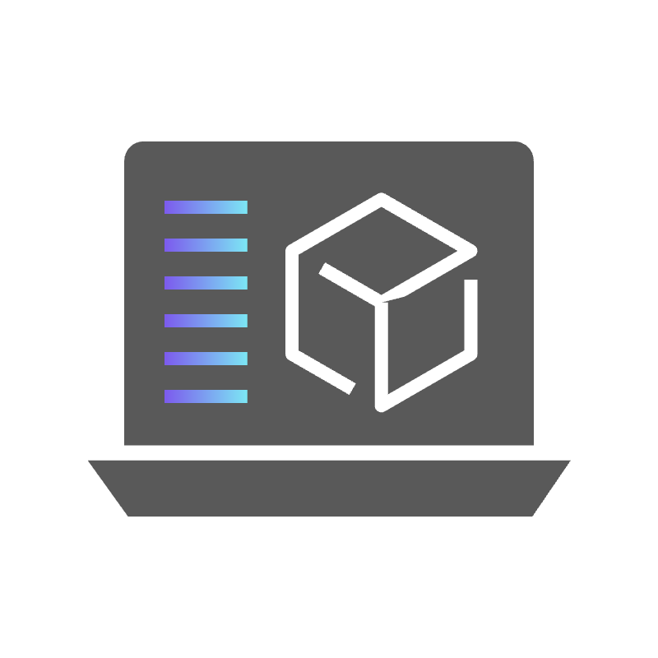
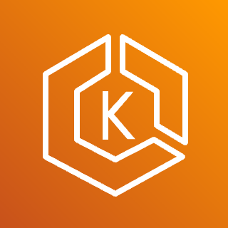

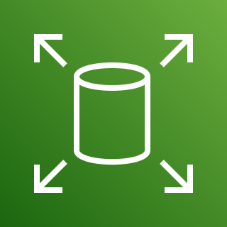
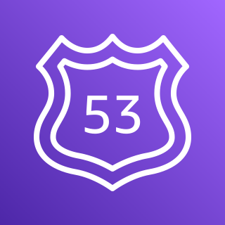
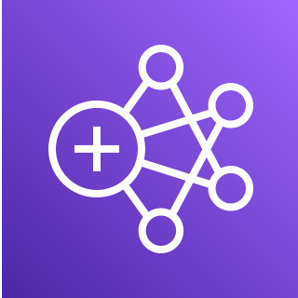
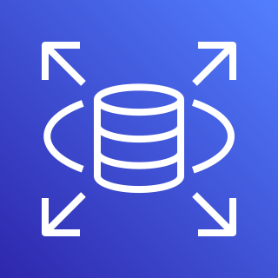
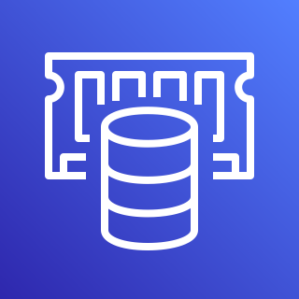

The operational model evolution
The Application Layer
Application development team
CI/CD tools and processes
The Infrastructure Layer
IaC tools and processes
Amazon EKS
Amazon S3
Amazon EBS
Amazon Route 53
Amazon EMR
Amazon RDS
ElastiCache
Amazon SNS
Infrastructure/ops team

Slide 7
The operational model evolution
The Infrastructure Layer
Change request
Deploy updates
Amazon EKS
Amazon S3
Amazon EBS
Amazon Route 53
Ticket
Application development team
Infrastructure/ops team
Amazon EMR
Amazon RDS
ElastiCache
Amazon SNS

Slide 8
How to overcome this challenges?
AppDev teams
Infra/ops teams
Autonomy
Standardization

Slide 9
Striking the balance
AppDev teams
Startups
Autonomy
Highly regulated enterprise
Standardization
Infra/ops teams

Slide 10
Striking the balance
AppDev teams
Autonomy
Are you here?
Standardization
Infra/ops teams

Slide 11
Striking the balance
Platform Engineering
AppDev teams
Autonomy
Standardization
Infra/ops teams

Slide 12
How to overcome that challenge?

Slide 13



Traditional ownership boundaries
Depends on
Codebase
CI/CD
Monitoring
Security
IaC
Codebase
CI/CD
Monitoring
Security
IaC
Codebase
CI/CD
Monitoring
Security
IaC
AppDev teams
Infra/ops teams

Slide 14
Shift-left without governance (aka wild west)
Codebase
CI/CD (GitOps)
Monitoring (CloudWatch)
Security (Top priority)
IaC (Terraform)
?
Codebase
CI/CD (AIOps)
Monitoring (Grafana)
Security (Maybe later)
IaC (CDK)
Codebase
CI/CD (ClickOps)
Monitoring (console.log)
Security (What?)
IaC (Bash + CLI)
AppDev teams
Infra/ops teams
Notes:
Part of platform’s recent popularity is due to the fact that modern application delivery approaches “shift left” many steps of the software delivery lifecycle. This makes sense because it shortens feedback cycles and avoids finger-pointing between teams. But it also means that development teams now not only do design and coding, but also distributed systems architecture, operations, and security design, causing a giant mental pile-up among those teams.

Slide 15
Shift-left empowered by Platform Engineering
Based on, empowered by
Codebase
CI/CD
Monitoring
Security
IaC
App blueprints
Tools and processes
Codebase
CI/CD
Monitoring
Security
IaC
IaC templates
Codebase
CI/CD
Monitoring
Security
IaC
Security and governance policies
AppDev teams
Platform team
Notes:
For this to work, modern teams would either have to be much smarter than before, or they would have to rely on better tooling, like–drum roll–Engineering Productivity Platforms that reduce the cognitive load for the teams. In my view the latter can work, but building such platforms isn’t easy, and not nearly everything labeled as platform would pass as one.
Ownership - platform is a product. Let me repeat it. Platform is a product. There must be a product owner, who’s having discussions with their customers (internal AppDev teams). You build products for customers.
Level of abstraction – different teams might ask you for different levels of abstraction. E.g. some teams don’t want to touch traditional infrastructure at all, while others are adamant about owning e2e stack. Some teams might only ask you for CI/CD pipelines, others would want the full blueprint. There’s no silver bullet, the answer depends on your organization and appdev team reqs.
Adoption – “if you build it they will come” doesn’t work. You have to consider adoption from the very early stages of building the platform
Troubleshooting – everyone loves you when things are working as expected. The real test is when things go sideways. Does your platform provides enough troubleshooting capabilities? How can your internal customers use these capabilities?

Slide 16
How does those blueprints look like?

Slide 17
Kubernetes Objects are Spread out!
Application 1
Application 2
Application 3
Application 4
Horizontal Pod Autoscaler
Horizontal Pod Autoscaler
Horizontal Pod Autoscaler
Horizontal Pod Autoscaler
Deployment
Deployment
Deployment
Deployment
Ingress
Ingress
Ingress
Ingress
Service
Service
Service
Service
ConfigMap
ConfigMap
ConfigMap
ConfigMap
AppDev teams
AppDev teams
AppDev teams
AppDev teams
Notes:
K8s objects can be created as “standalone” objects, or can be controlled (by controller/s) from another K8s object.
The basic example will be the Pod. It is a standalone object that can be created on its own, or can be controlled by a ReplicaSet that will ensure that there are desired number of replicas of the pod, even if the pod is terminated for any reason

Slide 18
Packaging application definitions with Helm
AppDev teams
Application 1
Helm Chart (Blueprint)
Helm Release
Consume
Creates
Horizontal Pod Autoscaler
values.yaml
Horizontal Pod Autoscaler
Application 2
Deployment
Helm Release
Deployment
Creates
Maintain
Consume
Creates
Ingress
values.yaml
Ingress
Platform Team
Service
Application 3
Service
Helm Release
Consume
Creates
ConfigMap
values.yaml
ConfigMap
Notes:
Explain the benefits of using Helm Charts, and why its important as a Blueprint.

Slide 19
But what about Infrastructure?

Slide 20
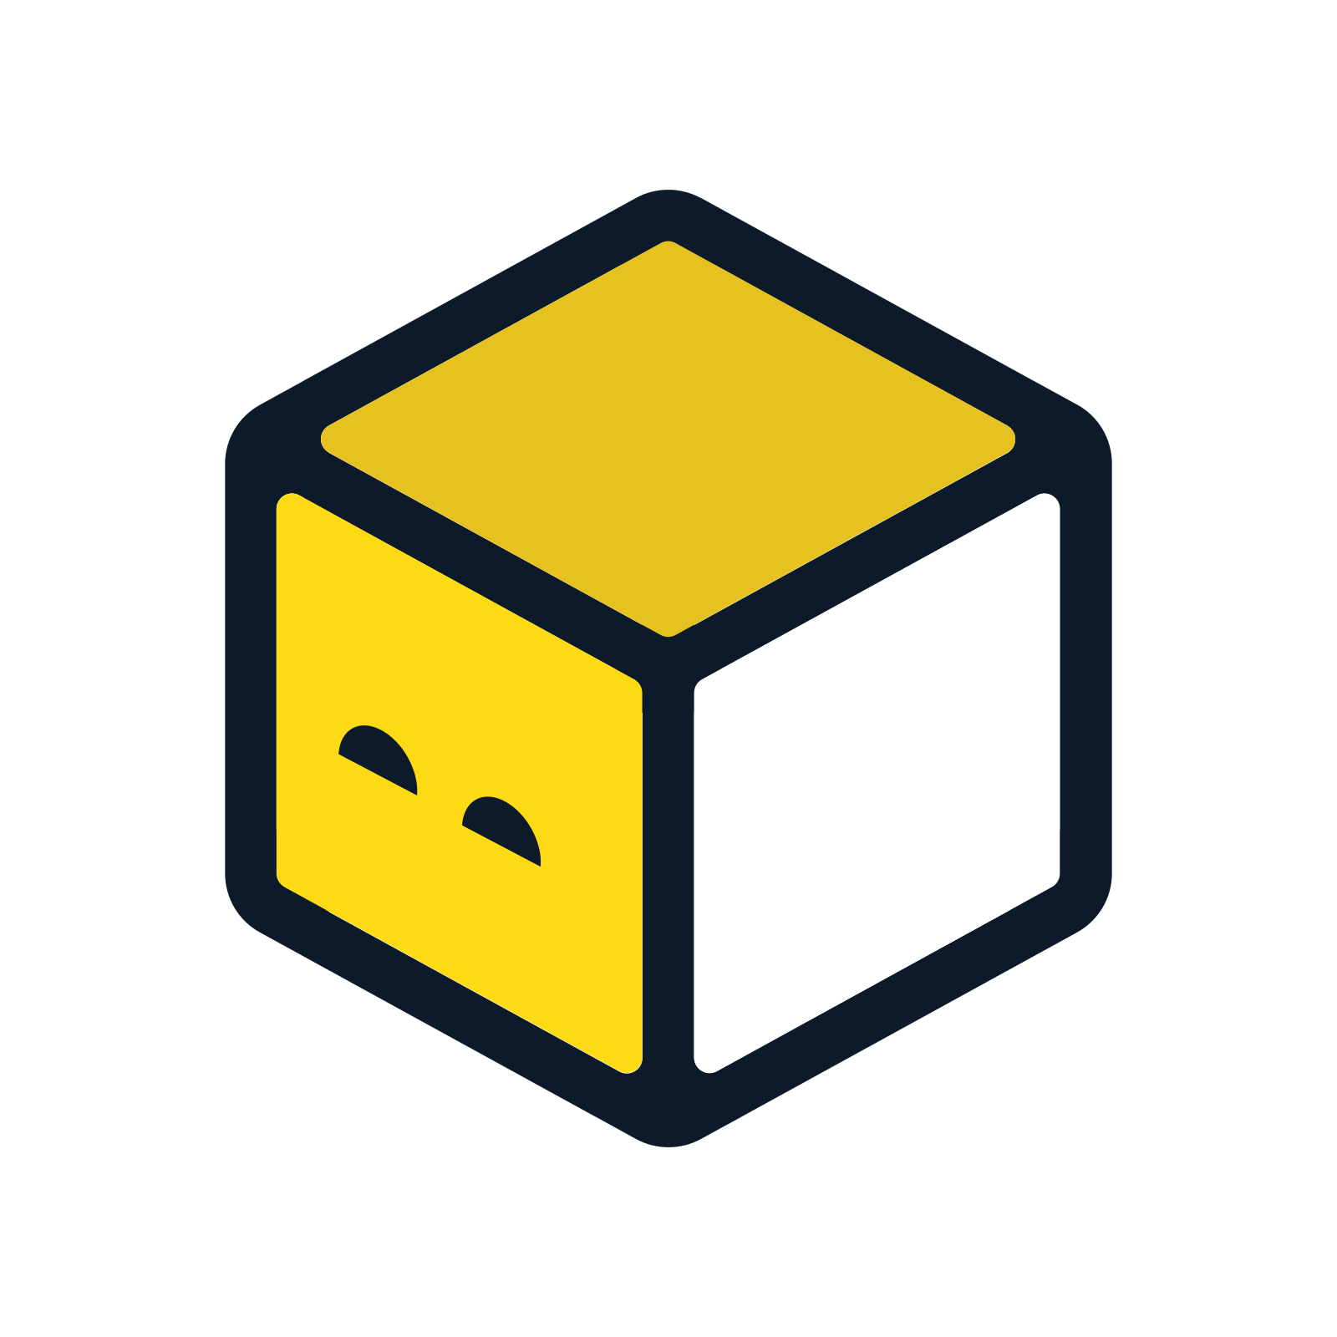
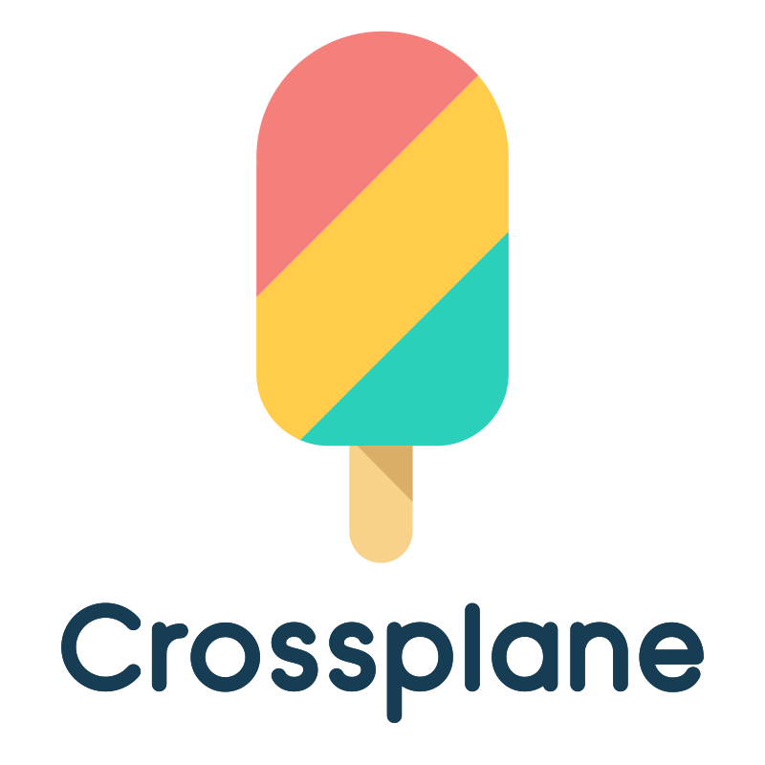
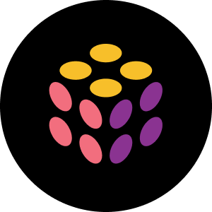
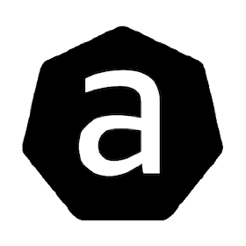
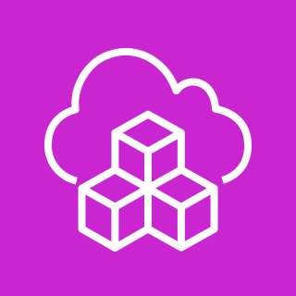

Infrastructure-as-code landscape
Code
HCL/JSON/YAML
K8S CRDs
Pulumi
OpenTofu / Terraform
Crossplane
AWS CDK
AWS CloudFormation
AWS Controllers
For Kubernetes
Notes:
Mention that if using ACK or Crossplane since already uses CRD and runs in Kubernetes, its easy to apply from the cluster

Slide 21
Infrastructure-as-code landscape
Code
HCL/JSON/YAML
K8S CRDs
Pulumi
OpenTofu / Terraform
Crossplane
AWS CDK
AWS CloudFormation
AWS Controllers
For Kubernetes
Notes:
Mention that if using ACK or Crossplane since already uses CRD and runs in Kubernetes, its easy to apply from the cluster

Slide 22


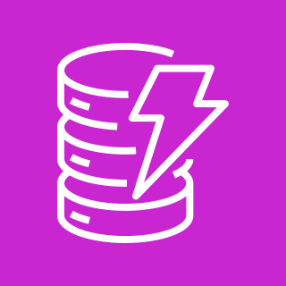
Terraform Modules
Terraform Resources
Terraform Modules
S3
Least Privilege
Amazon S3
Aggregated Module
Application 1
DynamoDB
Least Privilege
IAM
Amazon DynamoDB
Notes:
Just an example, the idea is to build abstractions, in this example we are using terraform because its easier to understand

Slide 23

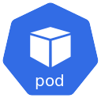
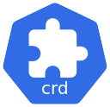
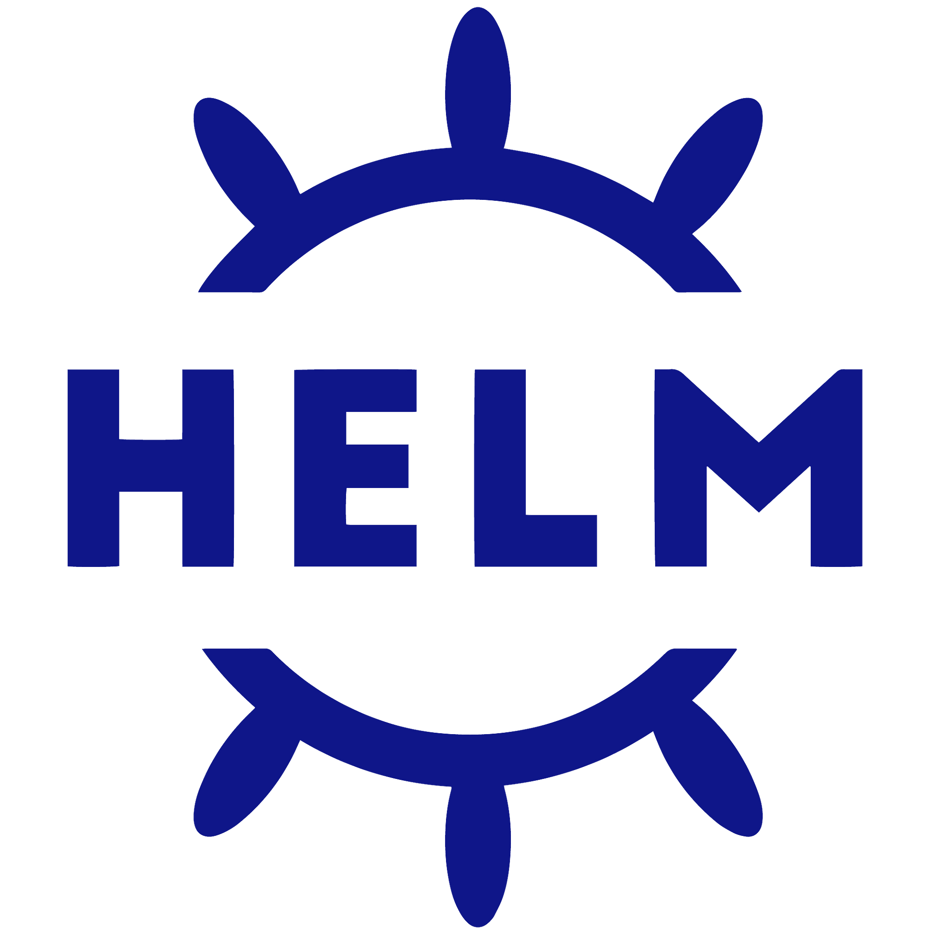

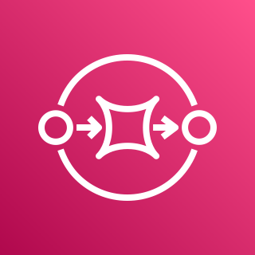
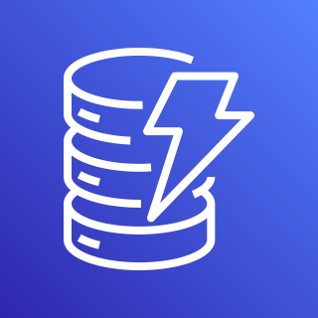
Tofu Controller
Amazon EKS
flux-system Namespace
Git Repository
Source Controller
TF-1
Terraform CRD
TF Controller
TF-Runner
Managed Resources
Secret
tfplan
Secret
tfstate
SQS
DynamoDB

Slide 24
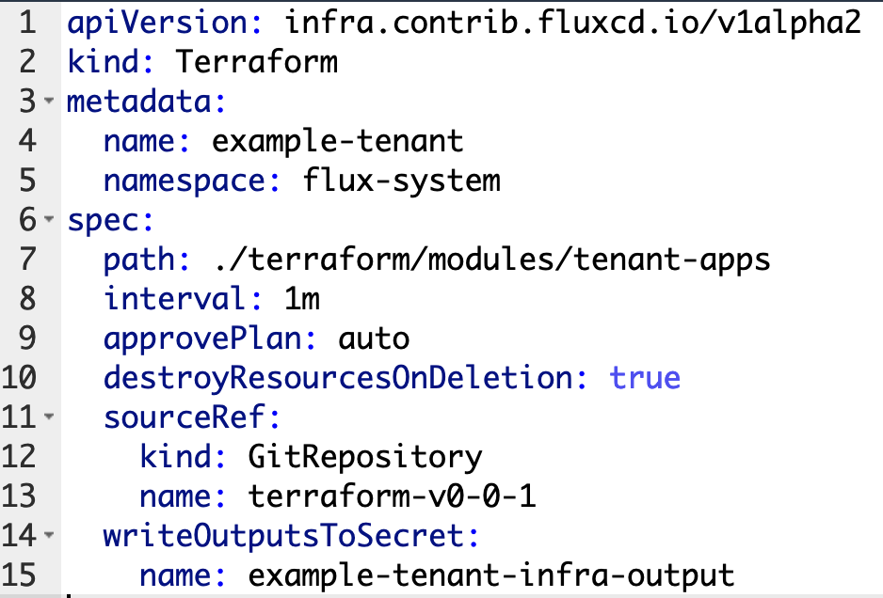
Tofu Controller
Helm Chart
Aggregated Module
Horizontal Pod Autoscaler
Application 1
Terraform CRD
Deployment
Ingress
Service
ConfigMap

Slide 25
Tofu Controller
Helm Chart
AppDev teams
Application 1
Aggregated Module
Helm Release
Horizontal Pod Autoscaler
Consume
Creates
values.yaml
Application 1
Terraform CRD
Application 2
Helm Release
Deployment
Consume
Creates
values.yaml
Ingress
Application 3
Service
Helm Release
Consume
Creates
values.yaml
ConfigMap

Slide 26
Empower developers with platform engineering
Infrastructure Blueprints
S3 Module
Git Repo
SQS Module
App Infra
Provisioned
Helm Chart
Frontend + Cloudfront
Application + Terraform Module
Create Maintain
Consume
Push
Platform
App Blueprints (Helm chart)
Developers
Application Code Deployed
Deployment
Ingress
Terraform CRD
Notes:
Contrasting with the centralized model, Developer-Driven Infrastructure advocates for a paradigm where developers are empowered to provision and manage their infrastructure components directly, within predefined security and governance frameworks. This model leverages automation and Infrastructure as Code (IaC) tools to provide developers with self-service capabilities, allowing for the rapid provisioning of infrastructure based on the specific needs of each application.
From Terraform Documentation: “Provide consistency and ensure best practices - Modules also help to provide consistency in your configurations. Not only does consistency make complex configurations easier to understand, it also helps to ensure that best practices are applied across all of your configuration. For instance, cloud providers give many options for configuring object storage services, such as Amazon S3 or Google Cloud Storage buckets. There have been many high-profile security incidents involving incorrectly secured object storage, and given the number of complex configuration options involved, it's easy to accidentally misconfigure these services.”

Slide 27
Empower developers with platform engineering
Infrastructure Blueprints
Isolation
Governance
S3 Module
Security
Standardization
Observability
Consistency
SQS Module
Frontend + Cloudfront
Git Repo
App Infra
Provisioned
Create Maintain
Consume
Helm Chart
Platform
App Blueprints (Helm chart)
Application + Terraform Module
Deployment
Push
Ingress
Developers
Application Code Deployed
Terraform CRD
Notes:
Contrasting with the centralized model, Developer-Driven Infrastructure advocates for a paradigm where developers are empowered to provision and manage their infrastructure components directly, within predefined security and governance frameworks. This model leverages automation and Infrastructure as Code (IaC) tools to provide developers with self-service capabilities, allowing for the rapid provisioning of infrastructure based on the specific needs of each application.
From Terraform Documentation: “Provide consistency and ensure best practices - Modules also help to provide consistency in your configurations. Not only does consistency make complex configurations easier to understand, it also helps to ensure that best practices are applied across all of your configuration. For instance, cloud providers give many options for configuring object storage services, such as Amazon S3 or Google Cloud Storage buckets. There have been many high-profile security incidents involving incorrectly secured object storage, and given the number of complex configuration options involved, it's easy to accidentally misconfigure these services.”

Slide 28
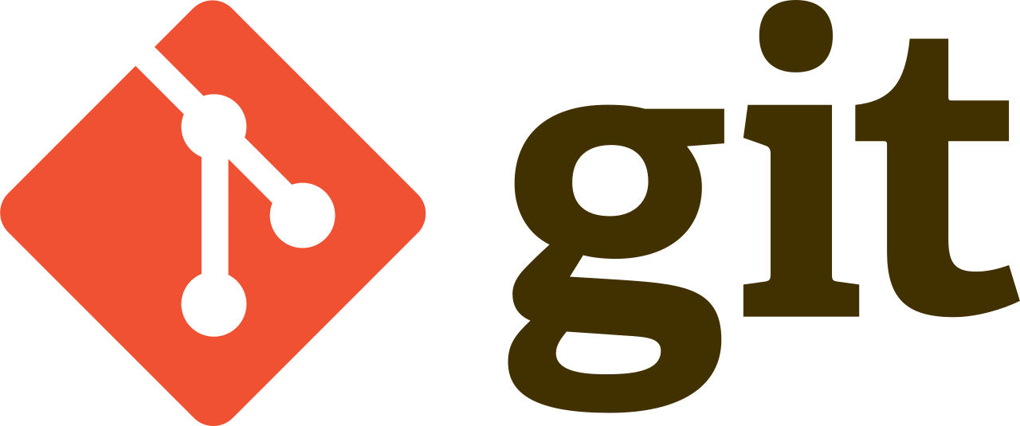
GitOps
Scan
Deploy/Verify
Git becomes the single source of truth for the desired system state, allowing for reproducible automated deployments, cluster management, and monitoring.
Test
Observe/Alert
Build
Operate/Fix
Immutability Firewall

Slide 29
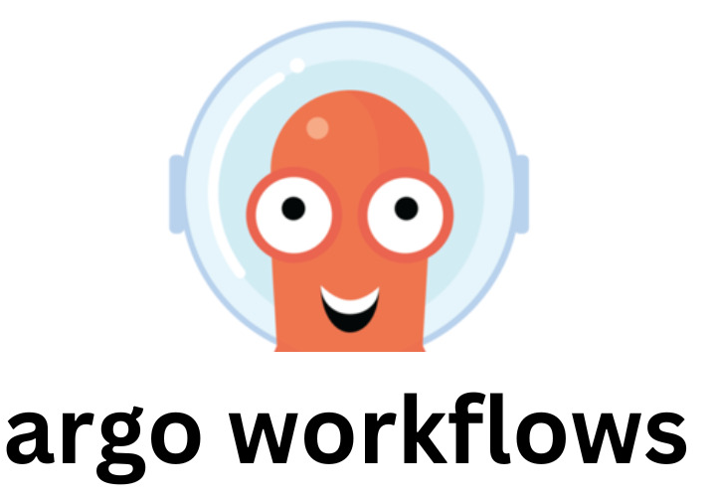
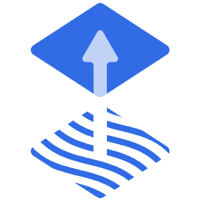

The workflow
Amazon EKS
Automation/Interface
Application 1
Helm Release
Aggregated Module
Controllers
Reconcile
Push
values.yaml
Application 1
Application 2
OpenTofu
Helm Release
FluxV2
Helm
values.yaml
Application 3
Helm Release
values.yaml

Slide 30
SaaS Tier Strategy
Basic Tier
Advanced Tier
Premium Tier
Shared Environment
Hybrid Environment
Dedicated Environment
Less Features
More Features
Premium Features
Higher Throttling
Lower Throttling
Adjustable Throttling
Limited Amount of Users
Support for more Users
Adjustable amount of Users
Lowest Cost
Medium Cost
Highest Cost

Slide 31
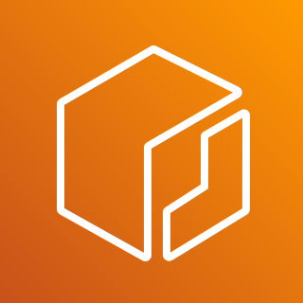
Putting it all together
Tenant Helm Chart
Basic Tenant
chart version: 0.0.x
producer:
enable: false
consumer:
enable: false
chart version: 0.0.x - Watch
Deployment
Amazon EKS
Service
Ingress
Reconcile
Terraform
Advanced Tenant
chart version: 0.0.x
producer:
enable: false
consumer:
enable: true
Controllers
values.yaml
producer:
enable: true
image: producer
tag: v0.0.1
ingress:
enable: true
consumer:
enable: true
image: producer
tag: v0.0.1
ingress:
enable: true
FluxV2
Helm
OpenTofu
Premium Tenant
chart version: 0.0.x
producer:
enable: true
consumer:
enable: true
tag: v0.0.1
OpenTofu / Terraform Repository
Notes:
Explain that for testing purposes we have an consumer and producer app.
When it comes to tenant applications, we employ a Tenant Helm Chart where microservice images, versions and terraform module are predefined in the chart's values.yaml, ensuring uniform deployment across all tenants. The Helm chart is linked to an external Terraform module, represented as a Terraform CRD, which packages the necessary infrastructure for provisioning.
The same helm chart is used across tenants, and by enabling and disabling variables we are telling what needs to be deployed.
Don’t need to explain ECR and Terraform Git tag again

Slide 32


Resources
GitHub Repo
AWS Workshop
Notes:
Explain that for testing purposes we have an consumer and producer app.
When it comes to tenant applications, we employ a Tenant Helm Chart where microservice images, versions and terraform module are predefined in the chart's values.yaml, ensuring uniform deployment across all tenants. The Helm chart is linked to an external Terraform module, represented as a Terraform CRD, which packages the necessary infrastructure for provisioning.
The same helm chart is used across tenants, and by enabling and disabling variables we are telling what needs to be deployed.
Don’t need to explain ECR and Terraform Git tag again

Slide 33



Thank you!
Tiago Reichert
Lucas Duarte
tiago-reichert
lucas-soriano-alves-duarte

